Slide 1
In the name of god
Created by:
Mojtaba Farjam, MD PhD,
member of ethics committee for research

Slide 2
Ethics and Professionalism in medical publication

Slide 3
Chapter I
-Data Ownership
-Authorship
-Why Authorship matters
-Who is an author
-Non-Author contributors
-Mega Projects
-Order of authors
-How to prevent conflict of interest
-Notes
-Acknowledgement

Slide 4
Data Ownership
Usually the owner of the data is the founder of the study.
For example, the data from Persian cohort study

Slide 5
Authorship
Authorship is the right for those who accept the responsibility of the accuracy, validity and reliability of the content of the study.

Slide 6
Why Authorship Matters?
Authorship confers credit and has important academic, social, and financial implications.
Authorship also implies responsibility and accountability for published work.
Some journals ask the role of each author

Slide 7
Who Is an Author?
Substantial contributions to the conception or design of the work; or the acquisition, analysis, or interpretation of data for the work; AND

Slide 8
Who Is an Author? (Continued)
Drafting the work or revising it critically for important intellectual content; AND

Slide 9
Who Is an Author? (Continued)
Final approval of the version to be published; AND

Slide 10
Who Is an Author? (Continued)
Agreement to be accountable for all aspects of the work in ensuring that questions related to the accuracy or integrity of any part of the work are appropriately investigated and resolved.

Slide 11
Non-Author Contributors
Contributors who meet fewer than all 4 of the above criteria for authorship should not be listed as authors, but they should be acknowledged.

Slide 12
Mega-projects
In mega-projects when very special surveys Is referred to each contributor, provided that the details of other parts are studied and known by each of the contributors and importantly the article is written by their direct contribution, and the final version is approved by all of them, by written inquiry from the corresponding author to the ethical committee, and via the approval of this committee, the missing criteria o authorship could be offered to the important contributors.

Slide 13
Order of authors
First author: The main responsibility of data collection, analysis of the data and writing of the first draft of the paper.
Corresponding Author: The author who corresponds with the journal and the publisher, sometimes supervises the project.
Last author: It is recommended that the who is more experienced in research accepts this position.
Other author(s): Depends on their role

Slide 14
How to prevent conflict of interest in authorship?
It is better to document all the agreements to divide the project into different sections and attribute sections to the contributors.
Determine which contributor can acquire the criteria of authorship and which one not.
Agree with all the authors about the rule, position, authorship order and if not author, put the name in the acknowledgment.
The quality of the work and the accountability of the author during the project has effect on the authorship order

Slide 15
Note
All the authors MUST:
Accept their responsibility regarding accuracy of the data reported and the content of the article.
Adhere to ethical guidelines of research in the I.R. Iran regarding human/animal studies.
Declare any conflict of interest upon submission of the paper.

Slide 16
Note
Disagreement regarding author position or an conflict of interest should be referred to ethical committee of the institute.*

Slide 17
Acknowledgment
People or institutes lacking the criteria of authorship but with contribution should be appreciated including their role.

Slide 18
Chapter II
-Incorrect authorships
-Redundant publication
-Plagiarism
-Data Fabrication
-Data Falsification

Slide 19
Incorrect Authorships
Guest author
Gift author
Ghost author

Slide 20
Redundant Publication
To publish similar data or results in different papers
Exceptions:
Proceedings?
Different languages?

Slide 21
Plagiarism
Plagiarism is the "wrongful appropriation" and "stealing and publication" of another author's "language, thoughts, ideas, or expressions“.
Exceptions
Direct quote/indirect quote?
General sentences (information)?

Slide 22
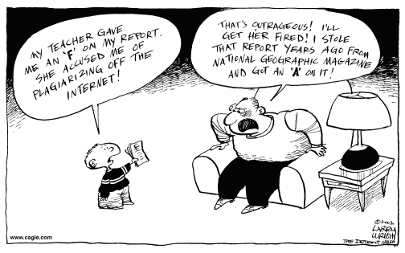

Slide 23
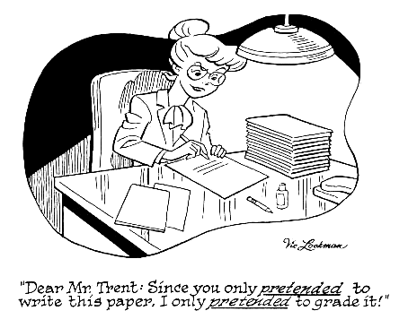

Slide 24
Data Fabrication Anti-plagiarism teachers website http://profs-against-plagiarism.blogspot.com

Slide 25
Data falsification
Data manipulation
Hiding Missing data
Neglecting outliers
Not declaring side effects

Slide 26
Chapter III
-Research Misconduct

Slide 27
Research misconduct
Major
Fabrication of data or cases
wilful distortion of data
plagiarism
no ethics approval
not admitting missing data
ignoring outliers
no data on side effects
gift authorship
redundant publication
failure to do adequate literature search
Minor

Slide 28
The end
Thank you for your attention

